Slide 1
LangChain Expression Language(LCEL)
LCEL is a way to compose multiple chains together
Streaming support
Optimized parallel execution

Slide 2
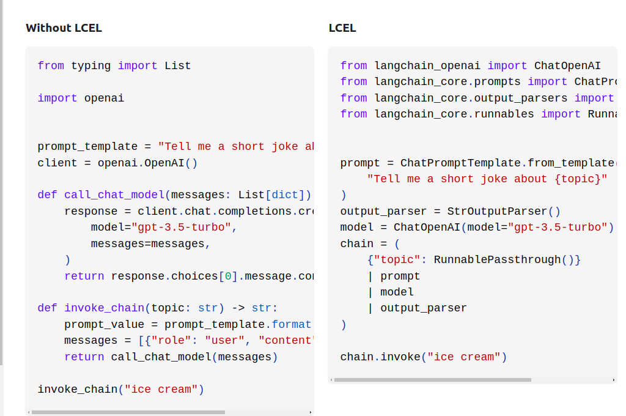

Slide 3
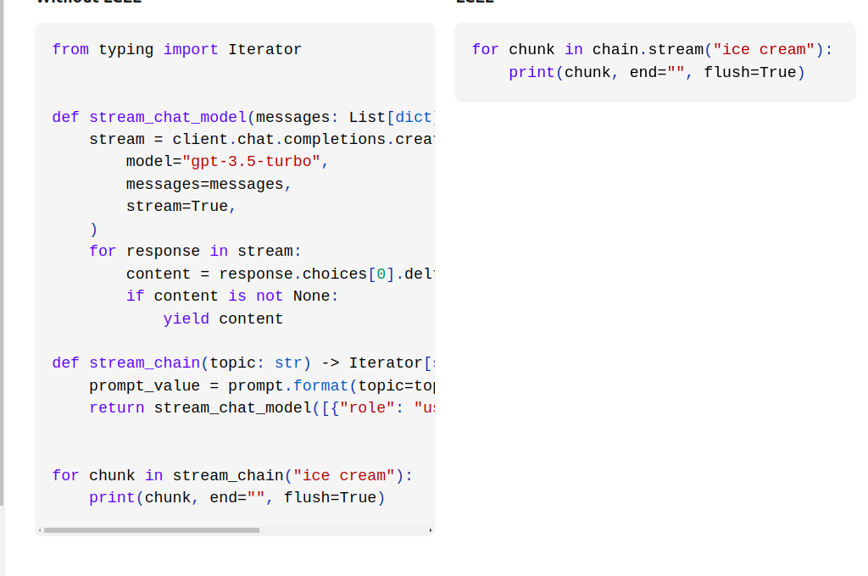

Slide 4
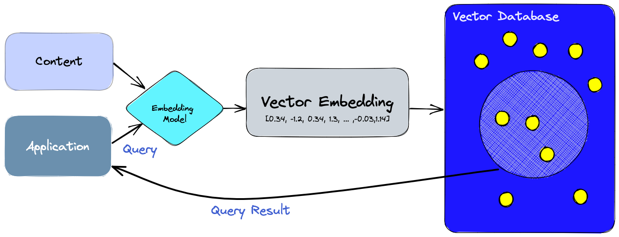

Slide 5
Memory
ConversationBufferWindow
EntityMemory
ConversationKnowledgeGraph
ConversationSummaryBuffer

Slide 6
